Slide 1
Sequential and timeseries data
Week 13
Ph.D. Junetae, Kim
Assistant professor

Slide 2
Contents
Introduction to time-series and sequential data
Introduction to recurrent neural networks (RNN) and long short-term memory models (LSTM)

Slide 3
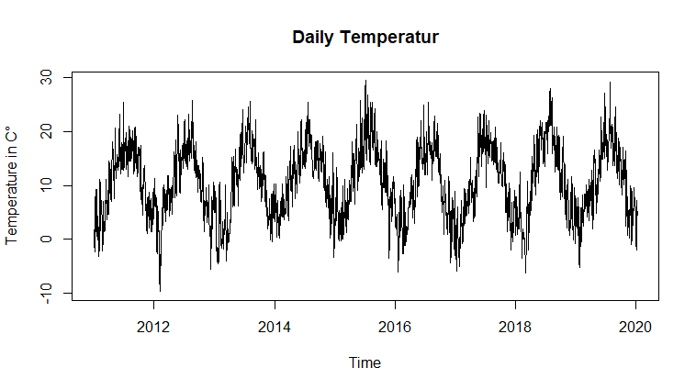
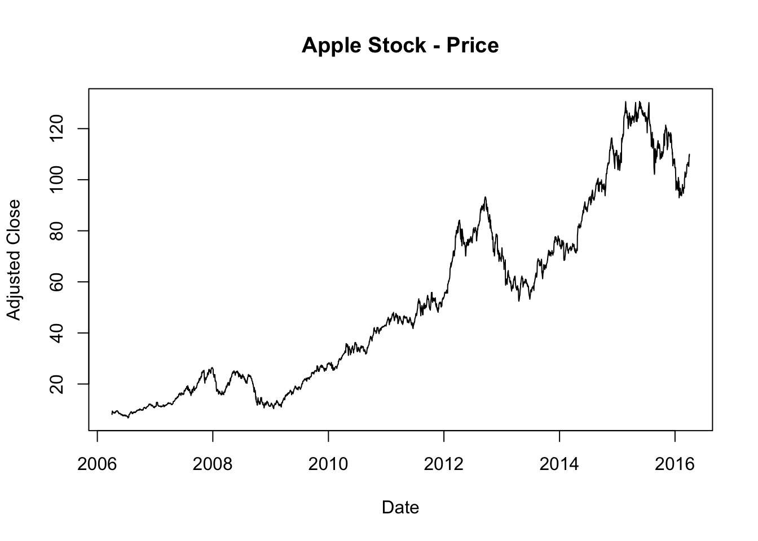
Introduction to sequential and timeseries data
Understanding timeseries data
Timeseries data refers to a collection of observations obtained through repeated measurements over time.
Examples: temperatures, stock prices, and annual retail sales.

Slide 4
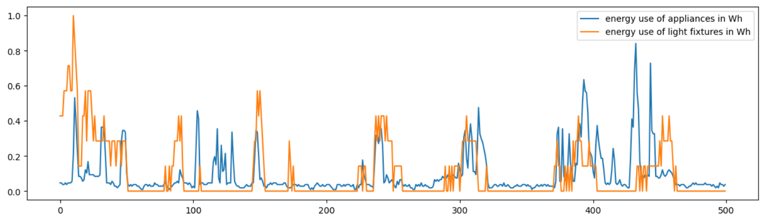
Introduction to sequential and timeseries data
Understanding dimensions of timeseries data
Time series data may consist of 1 or 2 dimensions, how?
Dimensions: (# of obs. , # of variables)
# of obs = 500
# of variables = 2

Slide 5
Introduction to sequential and timeseries data
Understanding dimensions of timeseries data
Understanding dimensions of timeseries forecasting from an algorithmic perspective
Input interval
Prediction interval
Time steps
Model
Variables
sample

Slide 6
Introduction to sequential and timeseries data
Understanding dimensions of timeseries data
Understanding dimensions of timeseries forecasting from an algorithmic perspective
Input interval
Prediction interval
Time steps
Variables
sample

Slide 7
Introduction to sequential and timeseries data
Understanding dimensions of timeseries data
Understanding dimensions of timeseries forecasting from an algorithmic perspective
Input interval
Prediction interval
Time steps
Variables
sample

Slide 8
Introduction to sequential and timeseries data
Understanding dimensions of timeseries data
Understanding dimensions of timeseries forecasting from an algorithmic perspective
Input interval
Prediction interval
Time steps
Variables
sample

Slide 9
Introduction to sequential and timeseries data
Understanding dimensions of timeseries data
Understanding dimensions of timeseries forecasting from an algorithmic perspective
Input interval
Prediction interval
Sliding window frame
Dimensions: (# of samples, # of time steps , # of variables)
# of samples = # of windows
# of time steps = window sizes
# of variables = variable sizes
Time steps
Variables
sample

Slide 10
Introduction to sequential and timeseries data
How to compose time series data in the form of a sliding window frame.
By using tf.signal.frame, data can be composed in the form of a sliding window frame.
tf.signal.frame(data, frame_length, frame_step)
frame_length: window size
frame_step: stride
https://colab.research.google.com/github/JunetaeKim/DeepLearningClass/blob/main/Week13/SlidingWindow.ipynb

Slide 11
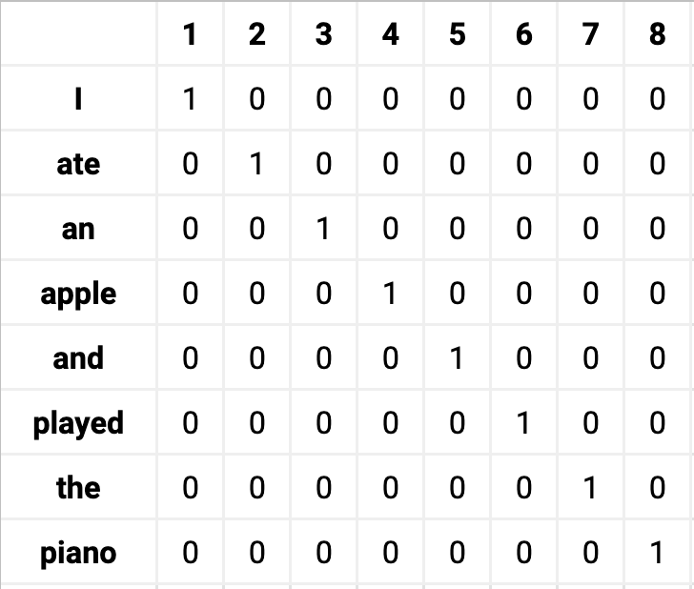
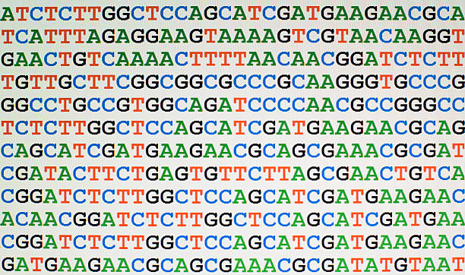
Introduction to sequential and timeseries data
Understanding sequential data
Sequential data refers to any data that contain elements that are ordered into sequences.
Examples: DNA sequences and Natural languages.
DNA sequences
Natural languages

Slide 12
Introduction to sequential and timeseries data
Understanding dimensions of sequential data
Sequential data may consist of 1 or 2 dimensions, how?
Alphabet data
A
B
C
D
…
W
X
Y
Z
1 | 0 | 0 | 0 | … | 0 | 0 | 0 | 0
0 | 1 | 0 | 0 | … | 0 | 0 | 0 | 0
0 | 0 | 1 | 0 | … | 0 | 0 | 0 | 0
0 | 0 | 0 | 1 | … | 0 | 0 | 0 | 0
0 | 0 | 0 | 0 | … | 0 | 0 | 0 | 0
0 | 0 | 0 | 0 | … | 1 | 0 | 0 | 0
0 | 0 | 0 | 0 | … | 0 | 1 | 0 | 0
0 | 0 | 0 | 0 | … | 0 | 0 | 1 | 0
0 | 0 | 0 | 0 | … | 0 | 0 | 0 | 1
1D
2D by one-hot encoding

Slide 13
Introduction to sequential and timeseries data
One-hot encoding
How to conduct one-hot encoding?
https://colab.research.google.com/github/JunetaeKim/DeepLearningClass/blob/main/Week10/IrisOneHot.ipynb

Slide 14
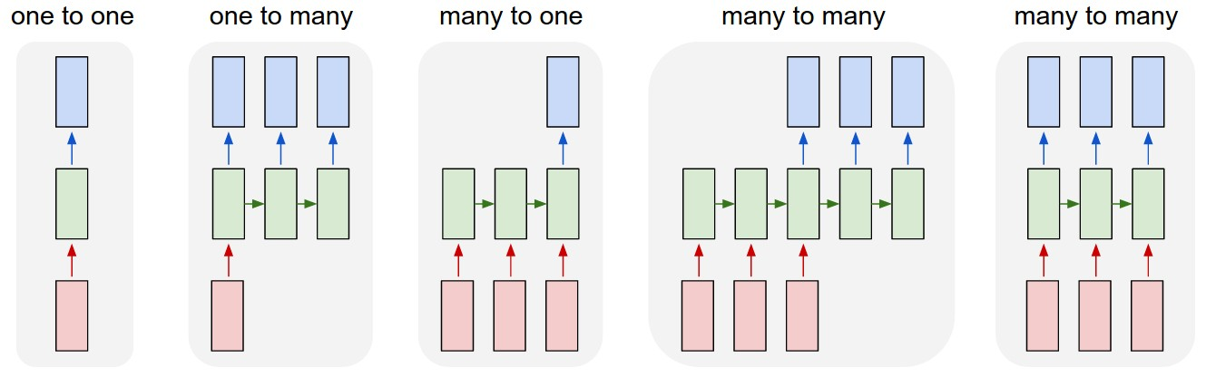
Introduction to sequential and timeseries data
Types of time series/sequence data prediction settings
1 to 1 : forecast the next data point given the previous data point
1 to m: barcode predictions
m to 1: sentiment analysis; positive or negative sentences
m to m: forecast the next m-series data points given the previous m-series data points
m to m: translational model; Korean to English
http://karpathy.github.io/2015/05/21/rnn-effectiveness/

Slide 15

Introduction to recurrent neural networks (RNN)
How can we employ sequential/timeseries data in neural network models?
Basically, recurrent neural networks are often used for time series data.
DNN/1dCNN can be used for sequential/timeseries data too.
RNN structure
x = a set of variables
h = output values
https://colah.github.io/posts/2015-08-Understanding-LSTMs/

Slide 16
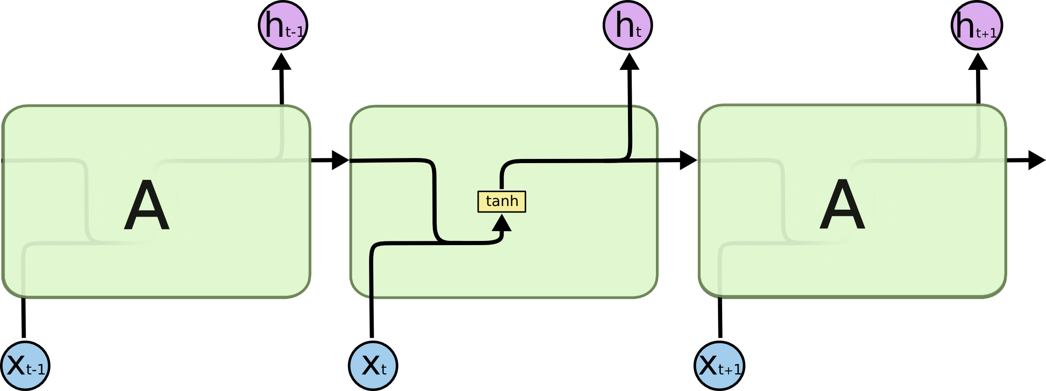
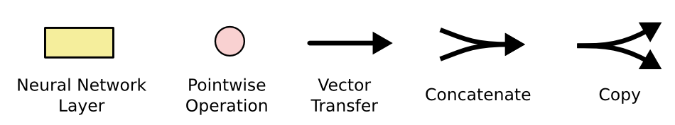
Introduction to recurrent neural networks (RNN)
Details in RNN
RNN has the form of a chain of repeating modules of neural network.
RNN can be thought of as multiple copies of the same weights.
W_{aa}
W_{ax}
+b_{a}
W_{aa} , W_{ax} and b_{a} in As are same.
https://colah.github.io/posts/2015-08-Understanding-LSTMs/

Slide 17
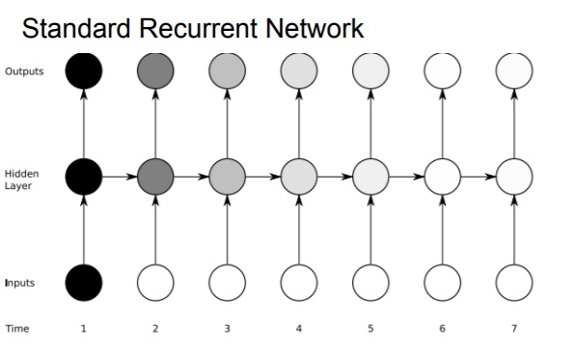
Introduction to recurrent neural networks (RNN)
Limitation of RNN: ‘long term dependency’
A long-term dependency problem is one in which the association becomes smaller as the distance between an input and an output increases.
The daker the shade, the greater the sensitivity
https://devopedia.org/long-short-term-memory

Slide 18
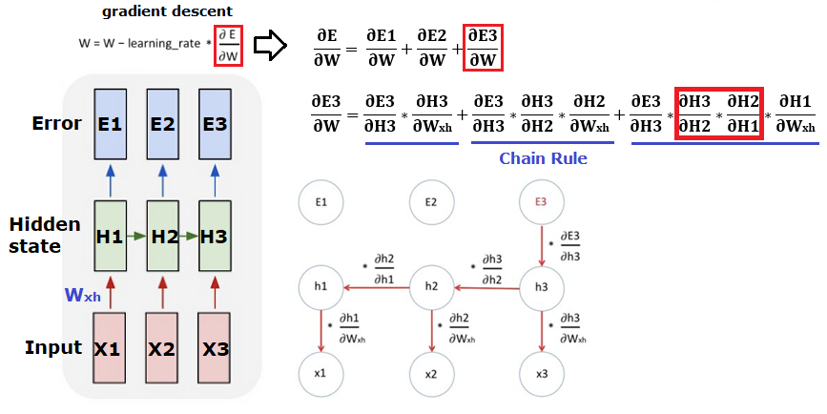
Introduction to recurrent neural networks (RNN)
Limitation of RNN: ‘long term dependency’
In RNN, the same weights are used repeatedly, so thus during the backpropagation, multiplying the derivatives by the weights multiple times causes exploding or vanishing gradients.
https://childult-programmer.tistory.com/55

Slide 19
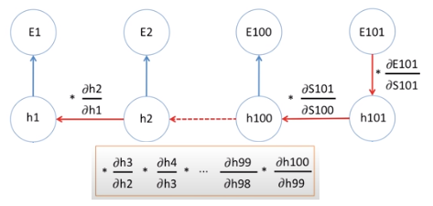
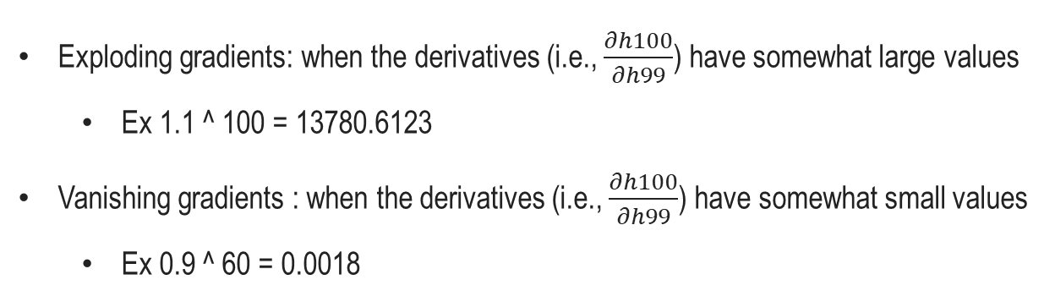
Introduction to recurrent neural networks (RNN)
Limitation of RNN: ‘long term dependency’
Exploding gradients: when the derivatives (i.e., $\frac{∂h100}{∂h99}$) have somewhat large values
Ex 1.1 ^ 100 = 13780.6123
Vanishing gradients : when the derivatives (i.e., $\frac{∂h100}{∂h99}$) have somewhat small values
Ex 0.9 ^ 60 = 0.0018
https://childult-programmer.tistory.com/55

Slide 20
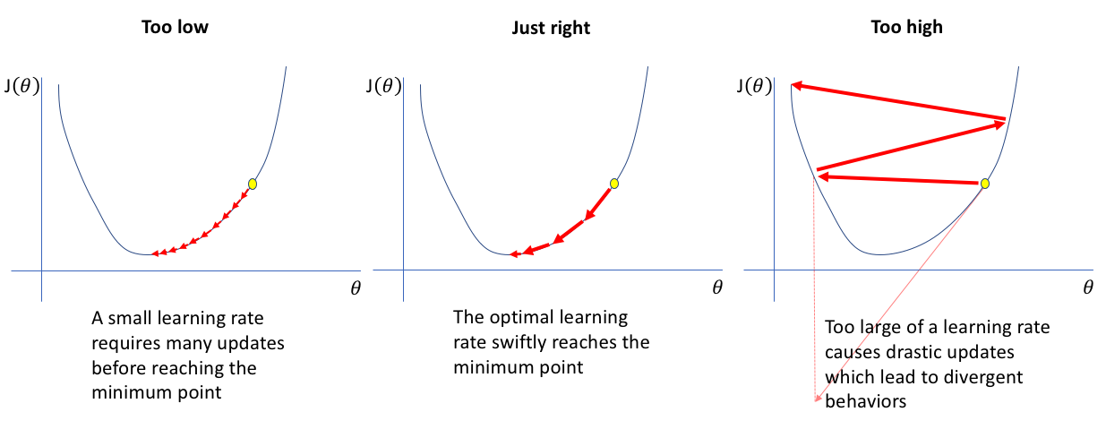
Introduction to recurrent neural networks (RNN)
Exploding gradients and Vanishing gradients
https://www.jeremyjordan.me/nn-learning-rate/

Slide 21

Introduction to Long Short-Term Memory (LSTM)
Introduction to LSTM
LSTM for overcoming exploding gradients and vanishing gradient problems.
It has the chain structure like RNNs, but the repeating module has a different structure; there are four mechanisms.
https://colah.github.io/posts/2015-08-Understanding-LSTMs/

Slide 22
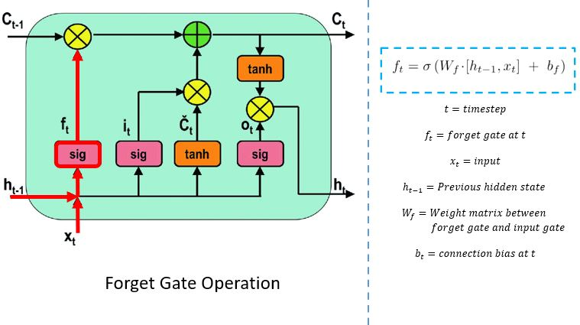
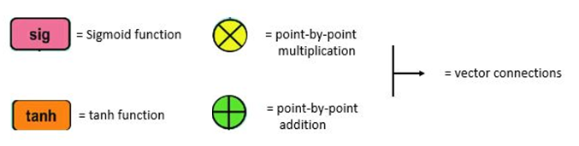
Introduction to Long Short-Term Memory (LSTM)
Details in LSTM
Forget Gate
The forget gate decides which information needs attention and which can be ignored.
The information from the current input X(t) and hidden state h(t-1) are passed through the sigmoid function.
Sigmoid generates values between 0 and 1.
It concludes whether the part of the old output is necessary (by giving the output closer to 1).
This value of f(t) will later be used by the cell for point-by-point multiplication.
https://www.pluralsight.com/guides/introduction-to-lstm-units-in-rnn

Slide 23
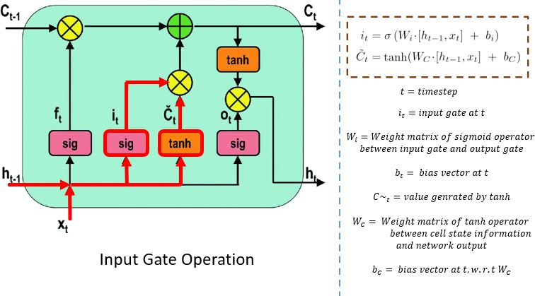
Introduction to Long Short-Term Memory (LSTM)
Details in LSTM
Input Gate
The input gate performs the following operations to update the cell status.
First, the current state X(t) and previously hidden state h(t-1) are passed into the second sigmoid function.
The values are transformed between 0 (important) and 1 (not-important).
https://www.pluralsight.com/guides/introduction-to-lstm-units-in-rnn

Slide 24
Introduction to Long Short-Term Memory (LSTM)
Details in LSTM
Input Gate
The input gate performs the following operations to update the cell status.
Next, the same information of the hidden state and current state will be passed through the tanh function.
To regulate the network, the tanh operator will create a vector (C~(t) ) with all the possible values between -1 and 1.
The output values generated from the activation functions are ready for point-by-point multiplication.
https://www.pluralsight.com/guides/introduction-to-lstm-units-in-rnn

Slide 25
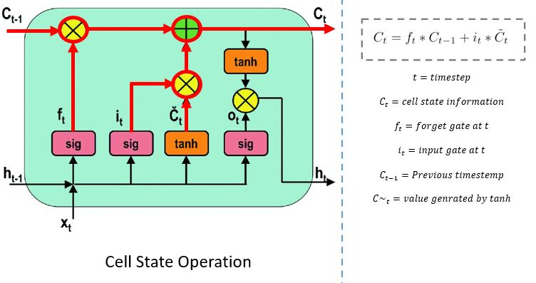
Introduction to Long Short-Term Memory (LSTM)
Details in LSTM
Cell State
Cell state decides and store the information from the new state in the cell state.
The network has enough information from the forget gate and input gate.
The previous cell state C(t-1) gets multiplied with forget vector f(t).
If the outcome is 0, then values(the previous information) will get dropped in the cell state.
https://www.pluralsight.com/guides/introduction-to-lstm-units-in-rnn

Slide 26
Introduction to Long Short-Term Memory (LSTM)
Details in LSTM
Cell State
Cell state decides and store the information from the new state in the cell state.
Next, the network takes the output value of the input vector i(t) and performs point-by-point addition, which updates the cell state giving the network a new cell state C(t).
https://www.pluralsight.com/guides/introduction-to-lstm-units-in-rnn

Slide 27
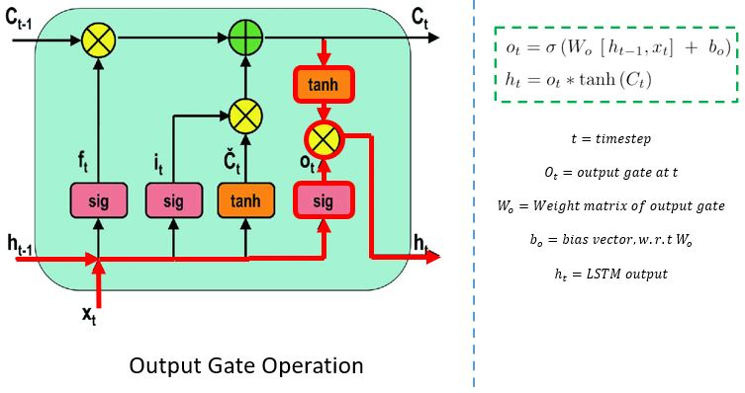
Introduction to Long Short-Term Memory (LSTM)
Details in LSTM
Output Gate
The output gate determines the value of the next hidden state. This state contains information on previous inputs.
First, the values of the current state and previous hidden state are passed into the third sigmoid function.
Then the new cell state generated from the cell state is passed through the tanh function.
Both these outputs are multiplied point-by-point.
https://www.pluralsight.com/guides/introduction-to-lstm-units-in-rnn

Slide 28
Introduction to Long Short-Term Memory (LSTM)
Details in LSTM
Output Gate
The output gate determines the value of the next hidden state. This state contains information on previous inputs.
Based upon the final value, the network decides which information the hidden state should carry.
This hidden state is used for prediction.
https://www.pluralsight.com/guides/introduction-to-lstm-units-in-rnn

Slide 29
Introduction to Long Short-Term Memory (LSTM)
For LSTM or RNN implementation
You may use tf.keras.layers.LSTM() or tf.keras.layers.SimpleRNN() to implement LSTM or RNN models, respectively.
Among the many arguments for LSTM implementation, the key arguments are:
units, activation='tanh’, recurrent_activation='sigmoid’, dropout=0.0, recurrent_dropout=0.0, return_sequences=False, return_state=False

Slide 30
Introduction to Long Short-Term Memory (LSTM)
For LSTM or RNN implementation
units = dimensionality of the output space; The number of LSTM bloks
A
A
A
A
A
A
A
A
A
A
A
A
Units

Slide 31
Introduction to Long Short-Term Memory (LSTM)
For LSTM or RNN implementation
activation vs recurrent_activation
activation is for cell state (default = ‘tanh’)
recurrent_activation is for input/forget/output gate (default = ‘sigmoid’)

Slide 32
Introduction to Long Short-Term Memory (LSTM)
For LSTM or RNN implementation
dropout vs recurrent_dropout
horizontally
h_{t-1}
h_{t}
H_{t+1}
h_{t-1}
h_{t}
H_{t+1}
vertically
A
A
A
vertically
A
A
A
X_{t-1}
X_{t}
X_{t+1}
X_{t-1}
X_{t}
X_{t+1}
Dropout
Dropout + recurrent dropout
https://arxiv.org/pdf/1512.05287.pdf

Slide 33
Introduction to Long Short-Term Memory (LSTM)
For LSTM or RNN implementation
return_sequences,
h_{t-1}
h_{t}
H_{t+1}
H_{T}
A
A
A
A
A
A
X_{t-1}
X_{t}
X_{t+1}
X_{t-1}
X_{t}
X_{T}
return_sequences = True
return_sequences = False

Slide 34
Introduction to Long Short-Term Memory (LSTM)
For LSTM or RNN implementation
return_state: Whether to return the cell and hidden states
C_{T-1}
Last cell states
C_{T}
C_{T+1}
C_{T-1}
C_{T}
C_{T+1}
A
C_{T-1}
A
C_{T}
A
C_{T+1}
A
C_{T-1}
A
C_{T}
A
C_{T+1}
A
A
A
A
A
A
Units
H_{T-1}
H_{T}
H_{T+1}
H_{T-1}
H_{T}
H_{T+1}
H_{T-1}
H_{T}
H_{T+1}
H_{T-1}
H_{T}
H_{T+1}
Last hidden states

Slide 35
Introduction to Long Short-Term Memory (LSTM)
Techniques for building various LSTM models
Stacked LSTM
A
A
A
InpL = Input(shape=(TimeStep, VarSize))
LSTML = LSTM(Units, return_sequences=True)(InpL)
LSTML = LSTM(Units, return_sequences=False)(LSTML)
model = Model(InpL, LSTML)
A
A
A
X_{t-1}
X_{t}
X_{t+1}

Slide 36
Introduction to Long Short-Term Memory (LSTM)
Techniques for building various LSTM models
M to N LSTM
H_{T}
A
A
A
A
A
A
X_{t-1}
X_{t}
X_{t+1}
https://m.blog.naver.com/PostView.naver?isHttpsRedirect=true&blogId=chunjein&logNo=221589624838

Slide 37
Introduction to Long Short-Term Memory (LSTM)
Techniques for building various LSTM models
M to N LSTM
A
A
A
A
A
A
InpL = Input(shape=(TimeStep, VarSize))
LSTML = LSTM(Units, return_sequences=False)(InpL)
X_{t-1}
X_{t}
X_{t+1}

Slide 38
Introduction to Long Short-Term Memory (LSTM)
Techniques for building various LSTM models
M to N LSTM
A
A
A
A
A
A
LSTML = RepeatVector(Units)(LSTML)
LSTML = TimeDistributed(Dense(10))(LSTML)
X_{t-1}
X_{t}
X_{t+1}
https://m.blog.naver.com/PostView.naver?isHttpsRedirect=true&blogId=chunjein&logNo=221589624838

Slide 39
Introduction to Long Short-Term Memory (LSTM)
Techniques for building various LSTM models
RepeatVector
Repeats the input n times.
Copy
Copy
A
A
A
A
A
A
X_{t-1}
X_{t}
X_{t+1}

Slide 40
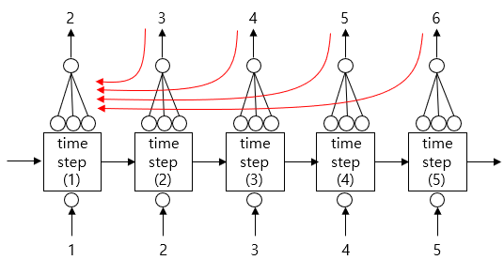
Introduction to Long Short-Term Memory (LSTM)
Techniques for building various LSTM models
TimeDistributed
This wrapper allows to apply a layer to every temporal slice of an input.
The errors calculated at each step is propagated through backpropagation.
‘ideal’
When TimeDistributed is applied.
https://m.blog.naver.com/PostView.naver?isHttpsRedirect=true&blogId=chunjein&logNo=221589624838

Slide 41
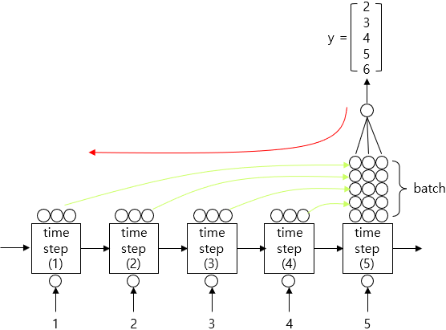
Introduction to Long Short-Term Memory (LSTM)
Techniques for building various LSTM models
TimeDistributed
This wrapper allows to apply a layer to every temporal slice of an input.
Errors in the intermediate output values ​​stacked in the last step are propagated through backpropagation.
‘non-ideal’
When TimeDistributed is not applied.
https://m.blog.naver.com/PostView.naver?isHttpsRedirect=true&blogId=chunjein&logNo=221589624838

Slide 42
Introduction to Long Short-Term Memory (LSTM)
Techniques for building various LSTM models
M to N LSTM
H_{T}
A
A
A
A
A
A
Output = LSTM(1, return_sequences=False)(LSTML)
X_{t-1}
X_{t}
X_{t+1}

Slide 43
Introduction to Long Short-Term Memory (LSTM)
Techniques for building various LSTM models
https://colab.research.google.com/github/JunetaeKim/DeepLearningClass/blob/main/Week13/LSTM.ipynb

Slide 44
Introduction to Long Short-Term Memory (LSTM)
Exercise1
m to n regression prediction of household energy use
Predicting energy use of appliances and light fixtures in Wh over an hour using 28 features over the previous 3 hours.
Y_{t+1}
Y_{t+2}
Y_{t+3}
A
A
A
A
A
A
A
A
A
A
A
A
X_{t-2}
X_{t-1}
X_{t}

Slide 45
Introduction to Long Short-Term Memory (LSTM)
Exercise1
m to n regression prediction of household energy use
The data set is at 10 min for about 4.5 months. The house temperature and humidity conditions were monitored with a ZigBee wireless sensor network. Each wireless node transmitted the temperature and humidity conditions around 3.3 min. Then, the wireless data was averaged for 10 minutes periods. The energy data was logged every 10 minutes with m-bus energy meters. Weather from the nearest airport weather station (Chievres Airport, Belgium) was downloaded from a public data set from Reliable Prognosis (rp5.ru), and merged together with the experimental data sets using the date and time column.
https://colab.research.google.com/github/JunetaeKim/DeepLearningClass/blob/main/Week13/HouseholdEnergyUse.ipynb

Slide 46
Introduction to Long Short-Term Memory (LSTM)
Exercise2
m to 1 classification of room occupancy
Predicting room occupancy using 28 variables recorded over approximately the last 20 minutes.
The experimental testbed for occupancy estimation was deployed in a 6m Ã— 4.6m room. The setup consisted of 7 sensor nodes and one edge node in a star configuration with the sensor nodes transmitting data to the edge every 30s using wireless transceivers. No HVAC systems were in use while the dataset was being collected.
Time: HH:MM:SS
Temperature: In degree Celsius
Light: In Lux
Sound: In Volts (amplifier output read by ADC)
CO2: In PPM
CO2 Slope: Slope of CO2 values taken in a sliding window
PIR: Binary value conveying motion detection
Room_Occupancy_Count: Ground Truth
Room_Occupancy
Y_{t+1}
A
A
A
A
A
A
X_{t-2}
X_{t-1}
X_{t}

Slide 47
Introduction to Long Short-Term Memory (LSTM)
Exercise2
For students
https://colab.research.google.com/github/JunetaeKim/DeepLearningClass/blob/main/Week13/OccupancyEstimation.ipynb
For solutions
https://colab.research.google.com/github/JunetaeKim/DeepLearningClass/blob/main/Week13/OccupancyEstimationSolution.ipynb

Slide 48
Introduction to Long Short-Term Memory (LSTM)
Exercise3
Alphabet sequence prediction
Input | Output
ABC | DEF
BCD | EFG
… | …
TUV | WXY
UVW | XYZ
https://colab.research.google.com/github/JunetaeKim/DeepLearningClass/blob/main/Week13/AlphabetSeq.ipynb

Slide 49
Introduction to Long Short-Term Memory (LSTM)
Exercise4
Developing a model to complete 10 letter words
Predicting the last 3 letters, given 7 letters.
Ground truth | Input | Output
abbreviate | abbrevi | ate
abdication | abdicat | ion
 | … | …
yesteryear | yestery | ear
zoological | zoologi | cal

Slide 50
Introduction to Long Short-Term Memory (LSTM)
Exercise4
For students
https://colab.research.google.com/github/JunetaeKim/DeepLearningClass/blob/main/Week13/10LetterWords.ipynb
For solutions
https://colab.research.google.com/github/JunetaeKim/DeepLearningClass/blob/main/Week13/10LetterWordsSolution.ipynb

